Slide 1
Digital Contact Book
Parul Institute of Computer Applications
Semester 2 Project -1
2020-21
Team members
1. 2005110101167 Varunkumar Singh C
2. 200510101161 Digpal Singh C
3. 200510101163 Madhav Singh C

Slide 2
INDEX
Abstract
Tools and Technology Used
Features of Proposed System
Limitation of Proposed System
Users and their role description
System Flow Diagram
Data Dictionary
Screenshots of Development Phase 1 ( Designing of your Project)
Screenshots of Development Phase 2 ( Features Implementation)
Screenshots of Development Phase 3 ( Features Implementation)
Conclusion
Future Enhancement
References

Slide 3
Abstract
This project is about creating a contact book . It’s an digital contact book which has been made with the user in mind. It can perform various functions . Its clean, simple and user friendly. It’s fast and more efficient then physical contact books . The user can learn to use it in just few minutes. It can be used across multiple platforms which support python.

Slide 4
Tools and Technology Used
Tools and Technologies to be used to develop the project is
PYTHON
Hardware Requirements
Processor : Intel Celeron or higher
Ram : 2gb or higher
Software Requirements
OS : Windows , Linux
Application : Python Interpretor

Slide 5
Features of Proposed System
It has various functions which is efficient and convenient for the user . It has functions such as :
1. We can Login
2. We can add contacts.
3. We can view contacts.
4. We an delete existing contacts.
5. We can reset contacts Fields.

Slide 6
Limitation of Proposed System
1. It can’t add secondary name or phone number.
2. It can’t run on platforms which does not support python language.
3. It is not connected to the cloud and it does not create backup files so one the contacts are deleted they cannot be accessed again.

Slide 7
Users and their role description
This is an single user System
The user can :
1. Login
2. Add contacts
3. Delete Contacts
4. Edit Contacts
5. View contacts
6. Reset the contact Field

Slide 8
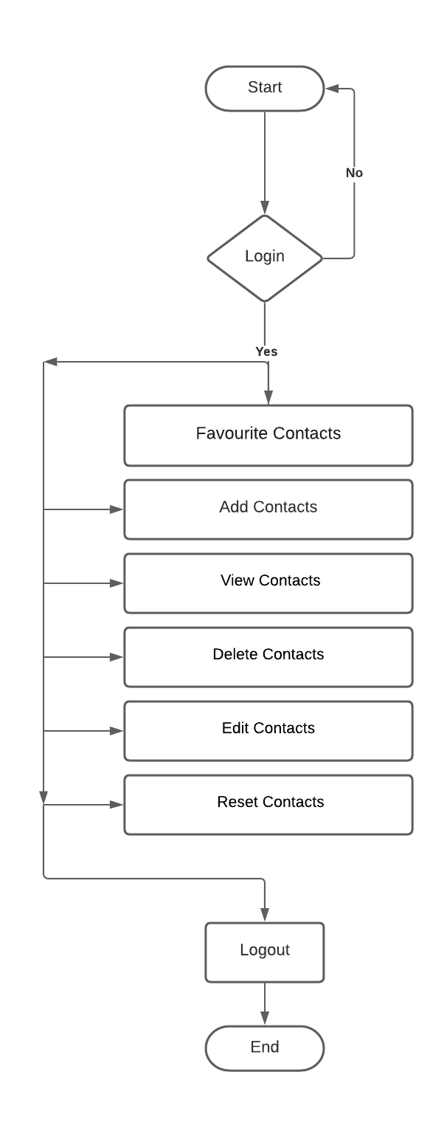
System Flow Diagram
Diagram of your System

Slide 9
Data Dictionary
Data Dictionary of your system
View Contacts
4.1 Contact Information
Users Information
Sr. No. | Field Name | Data Type | Size | Constraint | Description | Example
01 | Name | Varchar | 100 | Not Null | Contact Name | Digpal Singh
02 | Phone Number | Varchar | 100 | Not Null | Phone Number | 9680487642
03 | Default Contacts | Varchar | 100 | Not Null | Name and Contacts | Police , 101

Slide 10
Add Contacts
Contact Information
Sr. No. | Field Name | Data Type | Size | Constraint | Description | Example
01 | Name | Varchar | 100 | Not Null | Contact Name | Digpal Singh
02 | Phone Number | Varchar | 100 | Not Null | Phone Number | 9680487642
03 | Default Contacts | Varchar | 100 | Not Null | Emergency Services | Police 100

Slide 11
Edit Contacts Contact Information
Sr. No. | Field Name | Data Type | Size | Constraint | Description | Example
01 | Name | Varchar | 100 | Not Null | Contact Name | Digpal Singh
02 | Phone Number | Varchar | 100 | Not Null | Phone Number | 9680487642

Slide 12
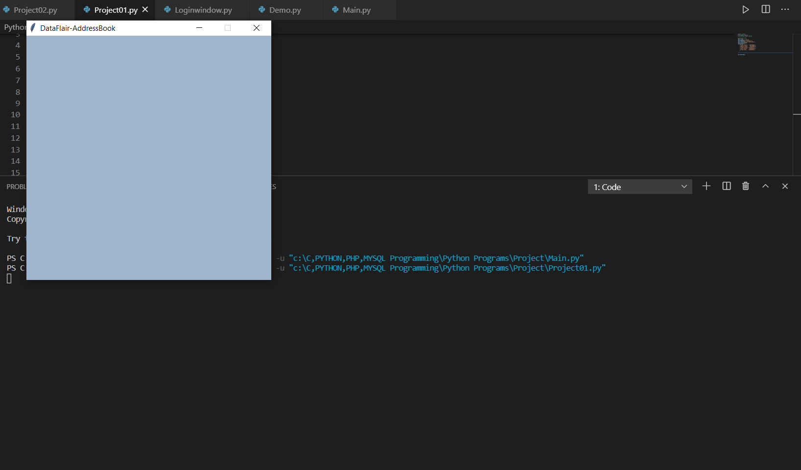
Screenshots of Development Phase 1 ( Designing of your Project)
Screenshots of Designing of your System

Slide 13
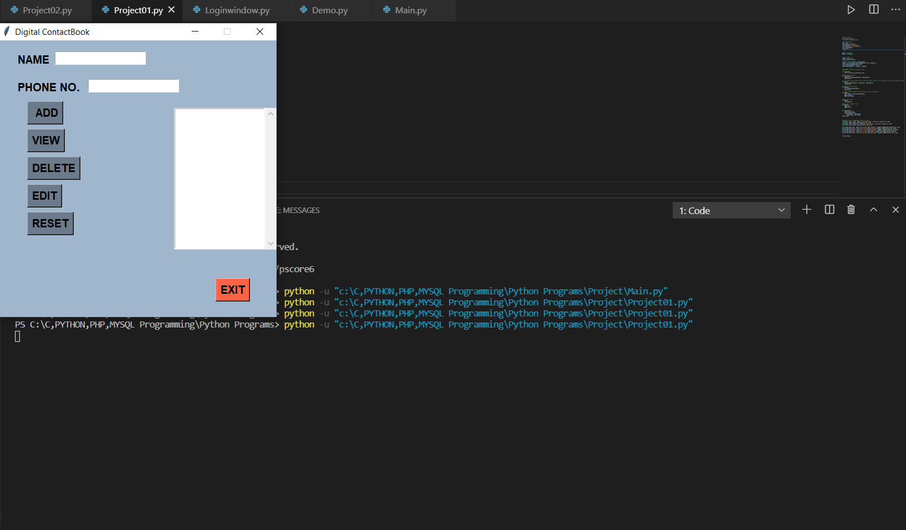
Screenshots of Development Phase 2 ( Features Implementation)
Screenshots of your System’s Features Implementation

Slide 14
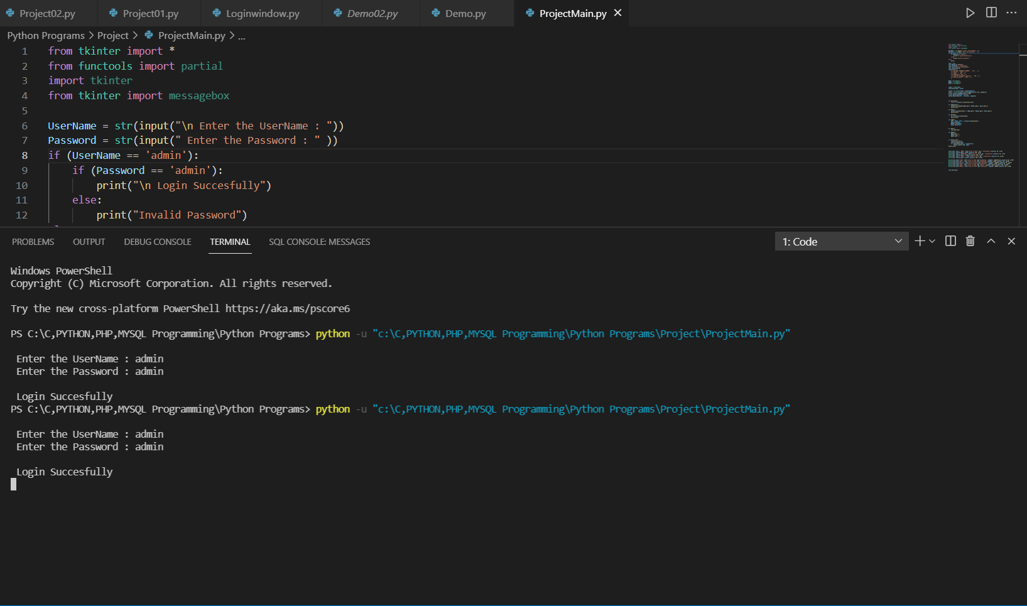
Screenshots of Development Phase 3 ( Features Implementation)
Screenshots of your System’s Features Implementation

Slide 15
Conclusion
Conclusion of your system
Development of Digital Contact Book was really on eye opening experience for our team and we learned a lot from the project development. In this digital contact book project, which is based on python language we were able to add may useful features that can provide help in the real world for the user. The projects program consists of many features such has the ability for the user to add contacts and edit existing contacts. The user can also view existing contacts on the list. There are also some default emergency contacts in the list for urgent use in case of emergency. The user can resent the form fields to blank to start their next use. We took help from many project development platforms such has Udemy, Python.org, w3schools. We look Forward for future project enhancement to make our work look and feel more efficient and user friendly with more features. We are glad that we the students of parul institute of computer application got the chance to develop this project with the help of our guide Prof Dharmendrasinh Rathod who gave us the required skills and ideas to develop this project.

Slide 16
Future Enhancement
We would like to add many more features in future such has adding address and connect our project to the internet and add database. We would also like to polish our project and add cloud save function.

Slide 17
References
Website:
https://www.python.org/about/gettingstarted/
https://www.geeksforgeeks.org/python-tkinter-tutorial/
https://www.youtube.com/watch?v=YXPyB4XeYLA
Book:
Let Us Python -Yashwant Kanetkar

Slide 18
Thank you !!!

